Slide 1

React Hooks🪝 & testing practices 🧪
@leimonio

Slide 2


Hi 👋
my name is
Konstantinos
const [🧑‍💻, ,🇬🇷, 🇬🇧, ☕️, 🏔] = 🙋‍♂️
@leimonio

Slide 3
What is the talk about?
State of react testing
First pitfalls
How to solve them?
What did I learn?
DEMO
@leimonio

Slide 4
2018 Working with React is great 🎉
Finally I can understand how to test React Components 🙌
@leimonio

Slide 5
2019 React Hooks released 🚀
This new feature looks great, I’ll turn all my components to React Hooks! 😎
@leimonio

Slide 6
Later in 2019... But how can I test React hooks? 🤔
@leimonio

Slide 7
Jest + Enzyme
First attempt to test React hooks
@leimonio

Slide 8

@leimonio

Slide 9
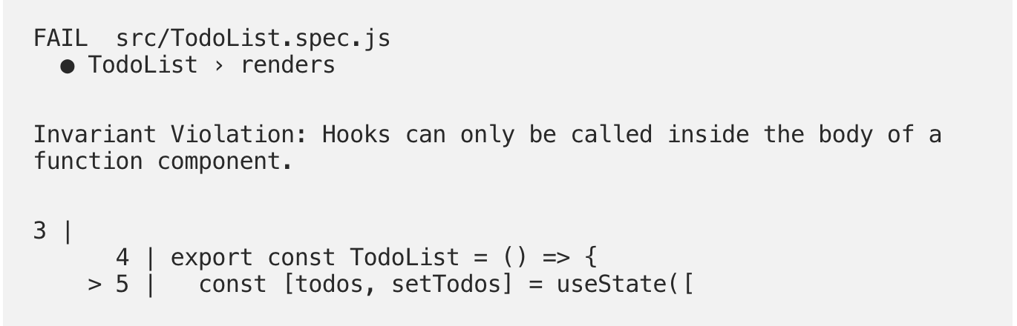
@leimonio

Slide 10
What’s this error? Is it my code? Is it hooks? Is it enzyme?
Let’s try to understand what’s going on under the hood
@leimonio

Slide 11
Let’s take a step back
@leimonio

Slide 12
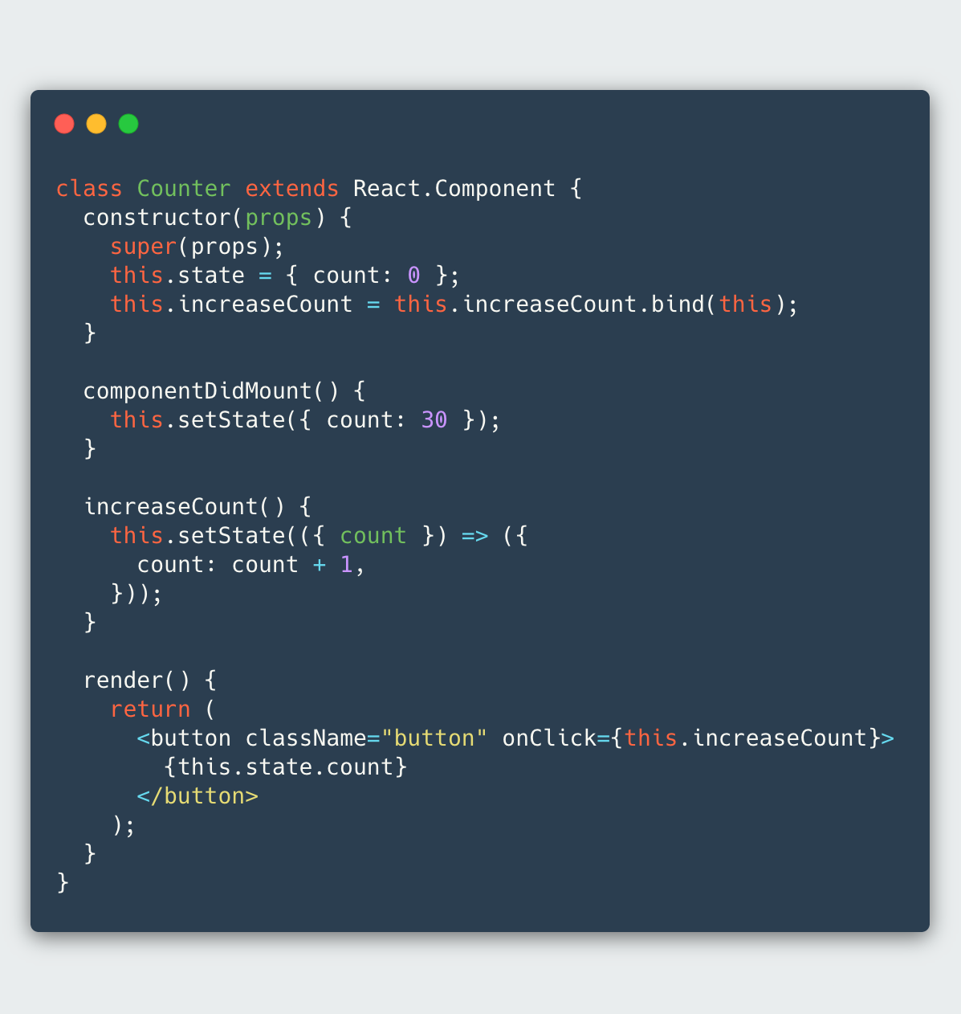
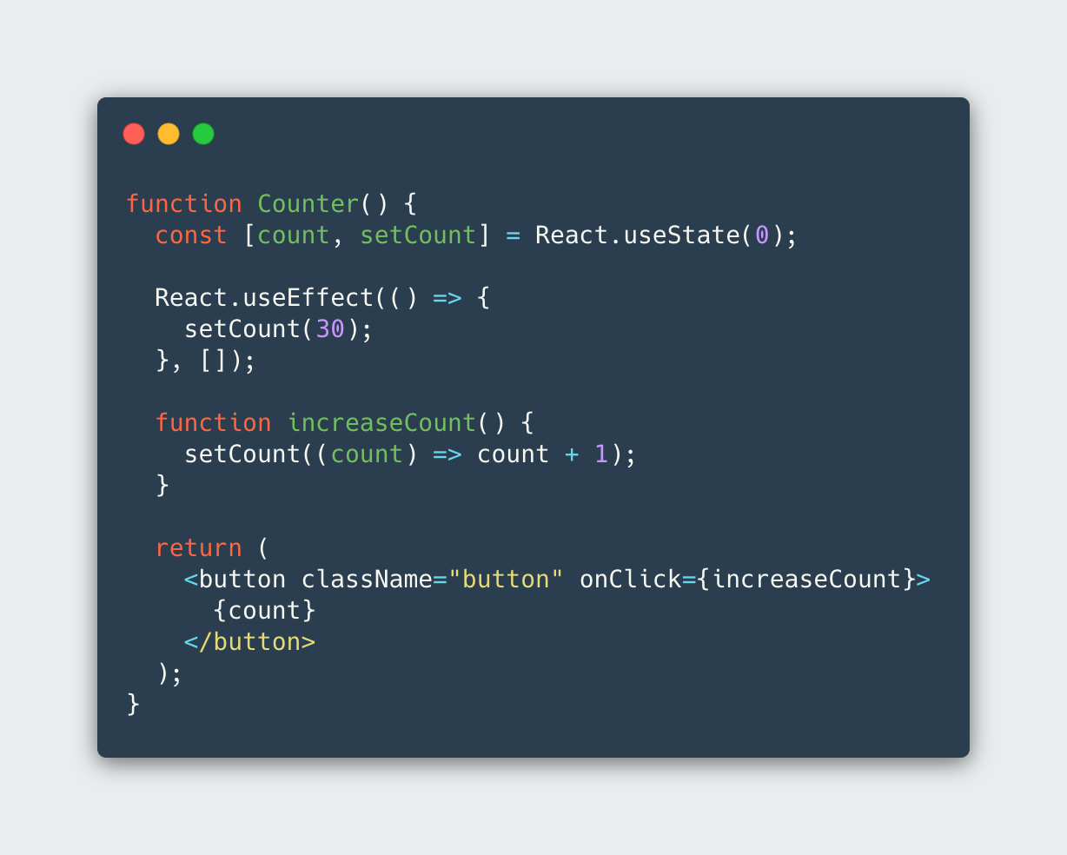
@leimonio

Slide 13
@leimonio

Slide 14
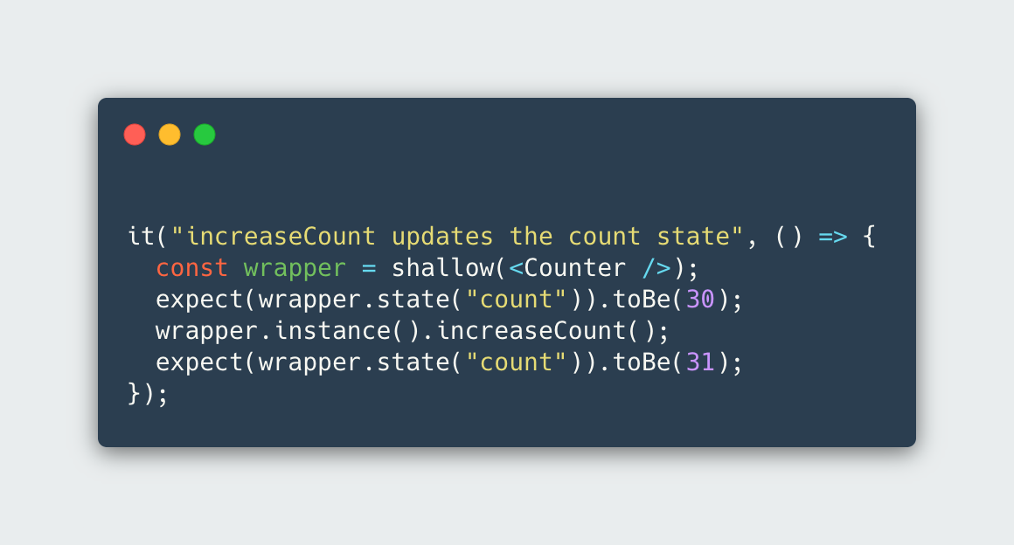
@leimonio

Slide 15
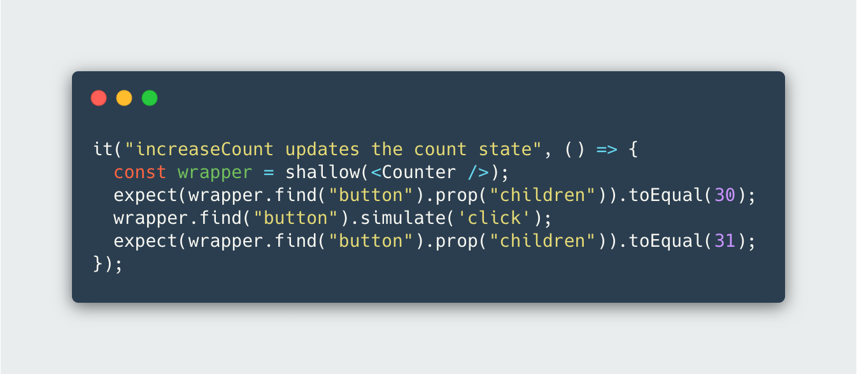
@leimonio

Slide 16
@leimonio

Slide 17

React Testing Library
@leimonio

Slide 18
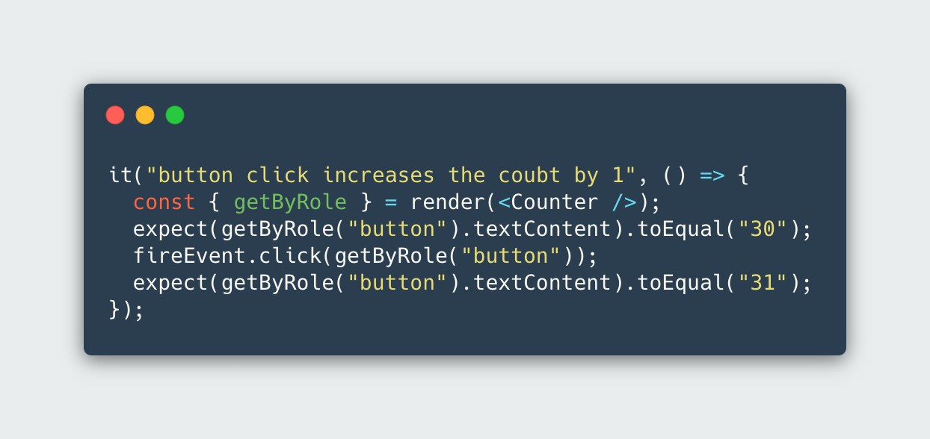
@leimonio

Slide 19
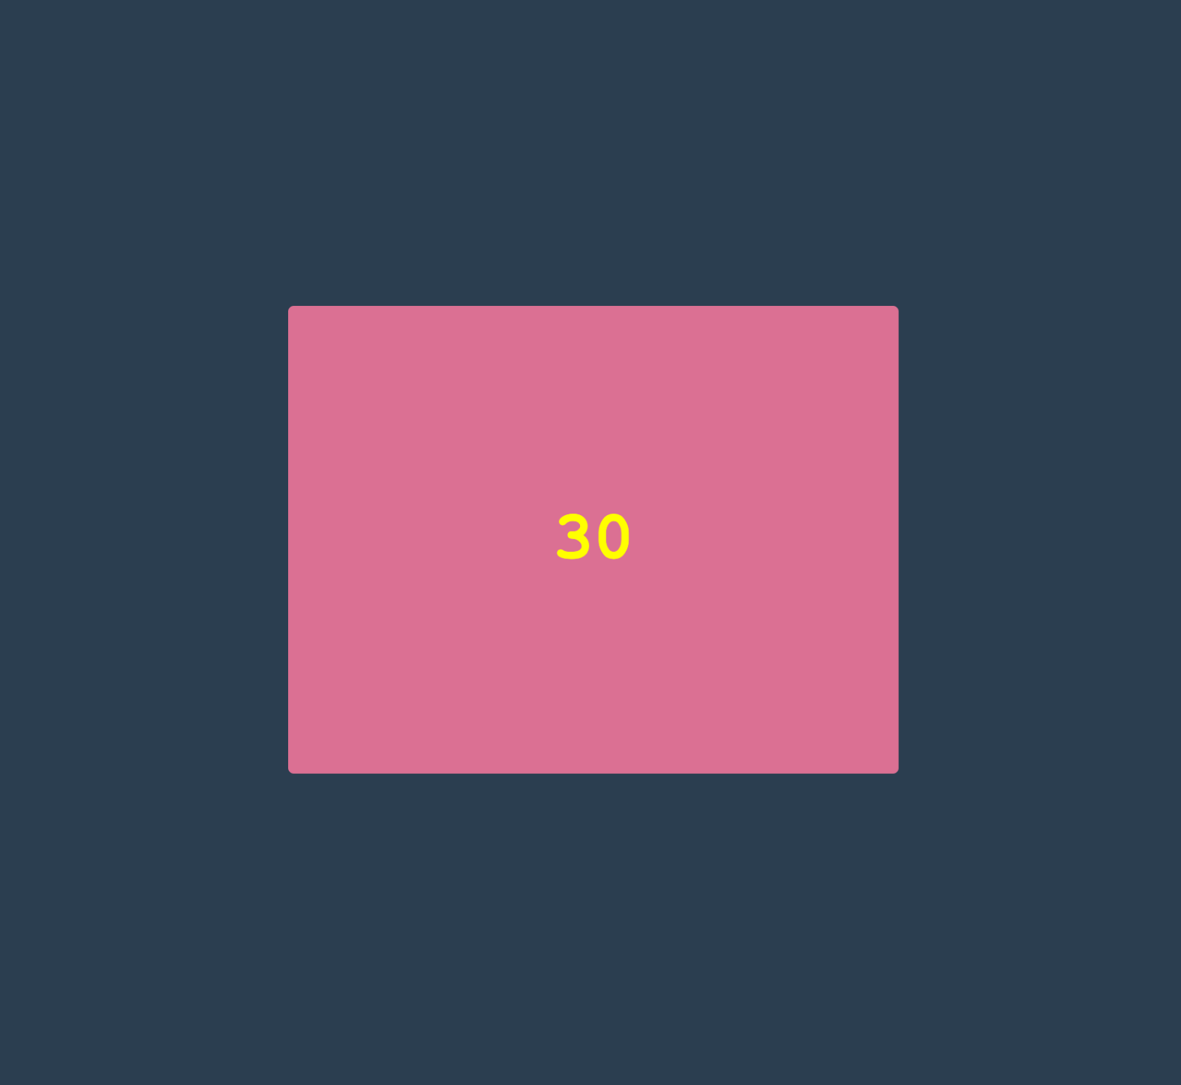
Example

Slide 20
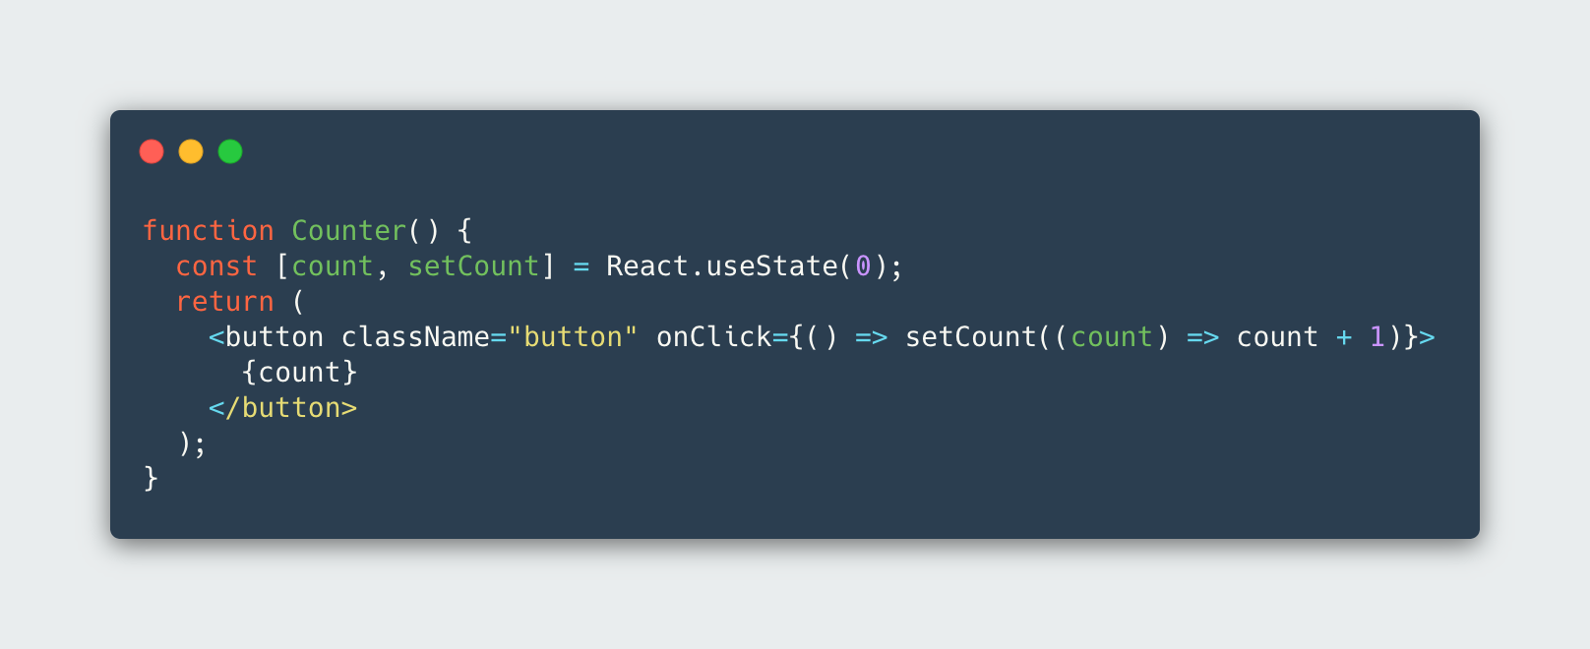
useState
@leimonio

Slide 21
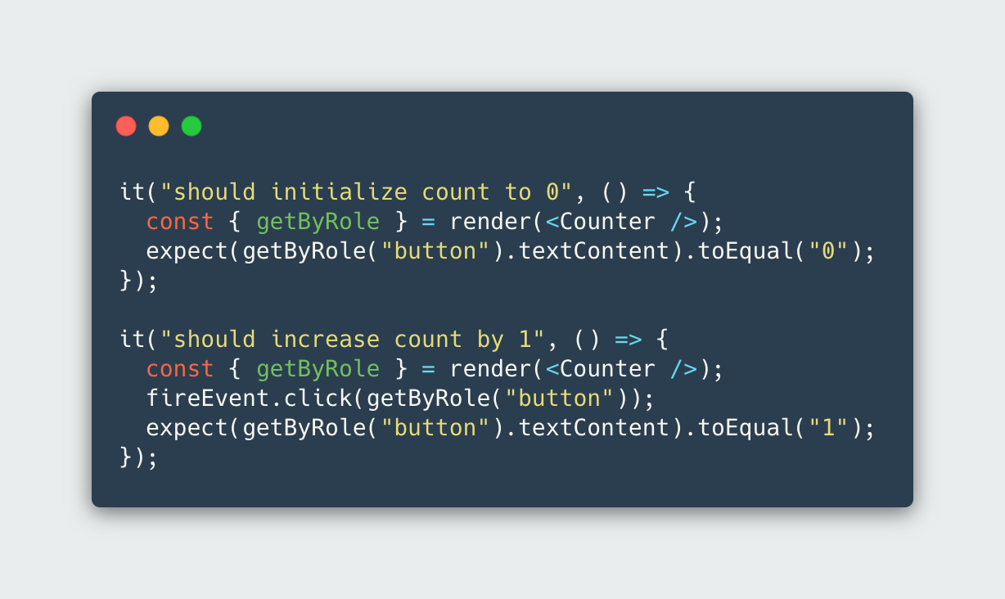
useState
@leimonio

Slide 22
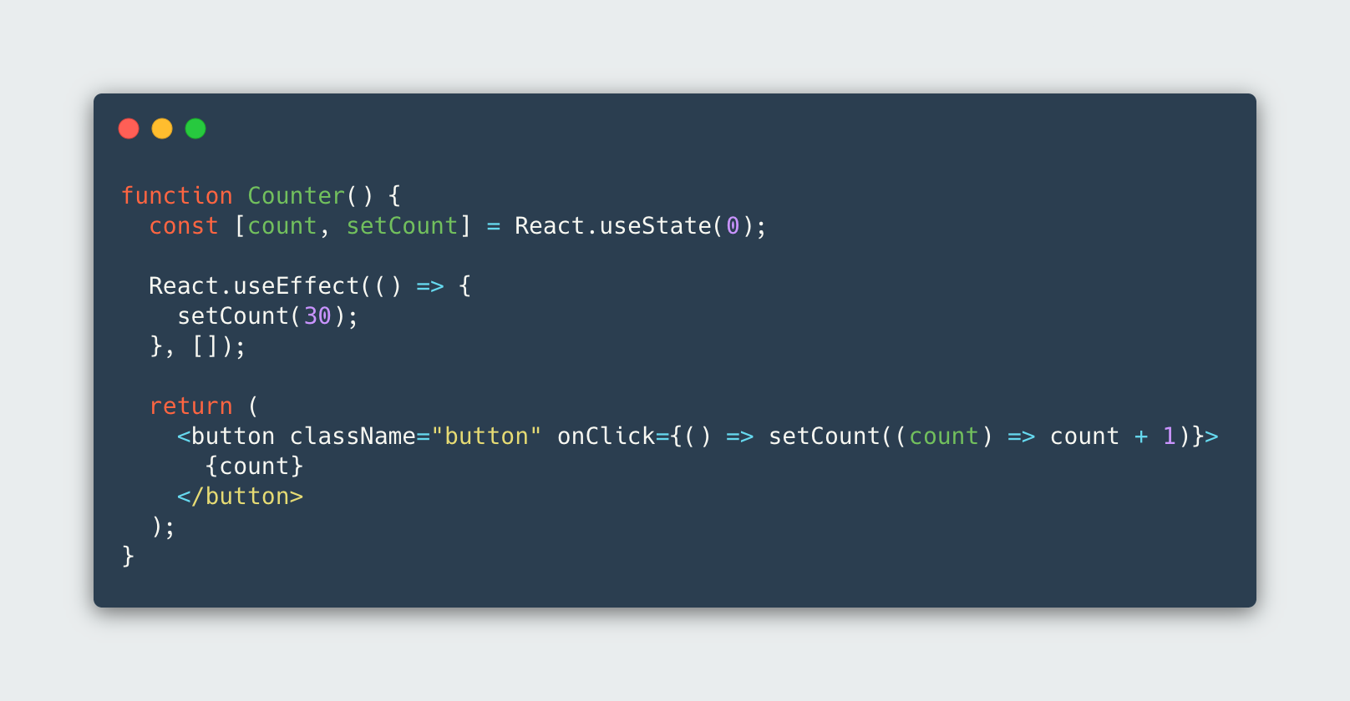
useEffect
@leimonio

Slide 23

useEffect
@leimonio

Slide 24
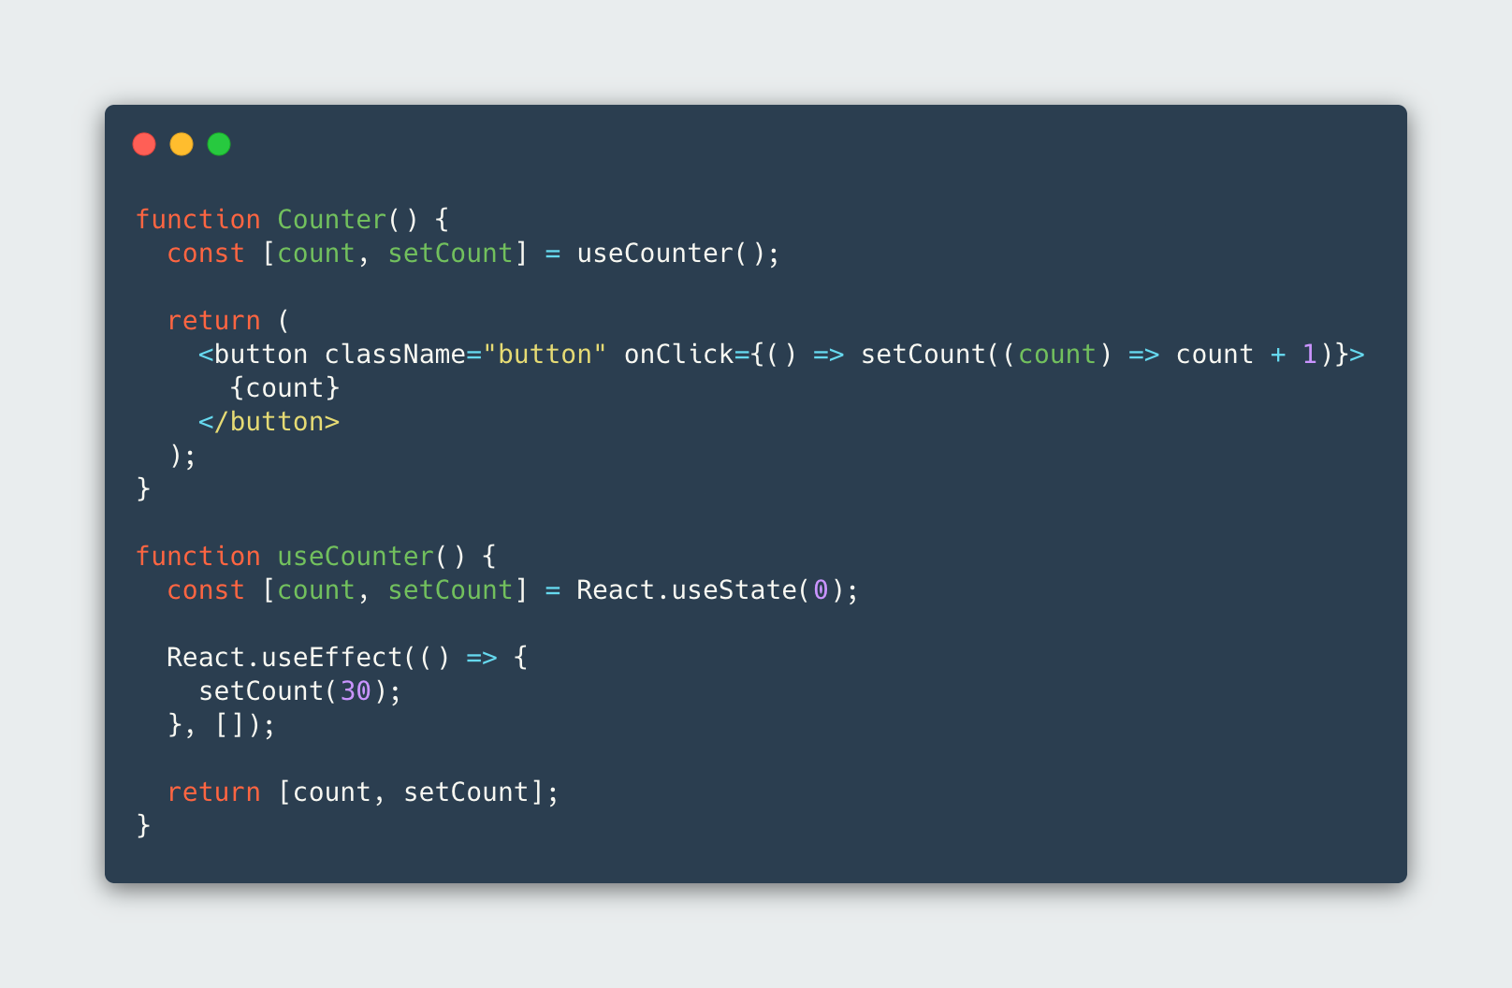
useCounter
@leimonio

Slide 25
useCounter
@leimonio

Slide 26
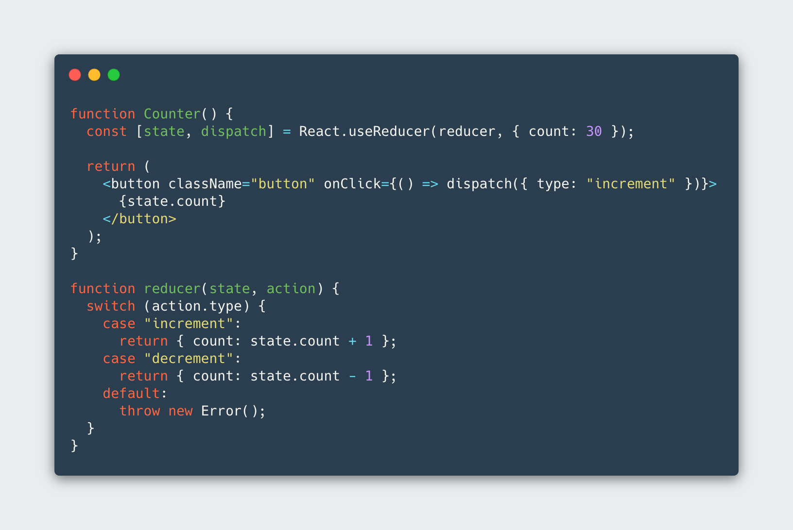
useReducer
@leimonio

Slide 27
useReducer
@leimonio

Slide 28
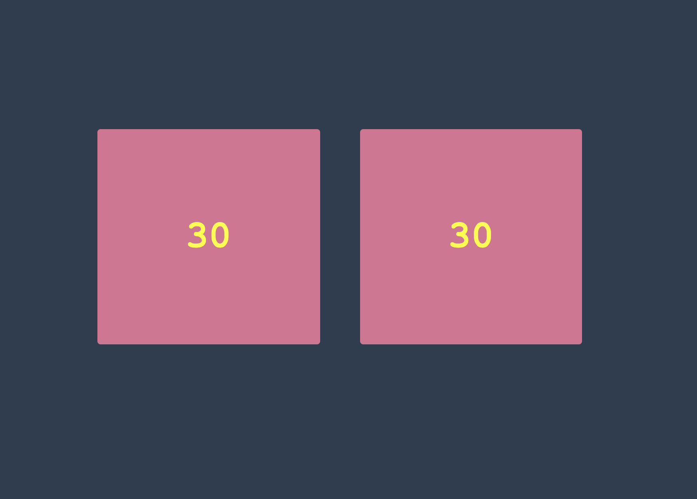
Example update
@leimonio

Slide 29
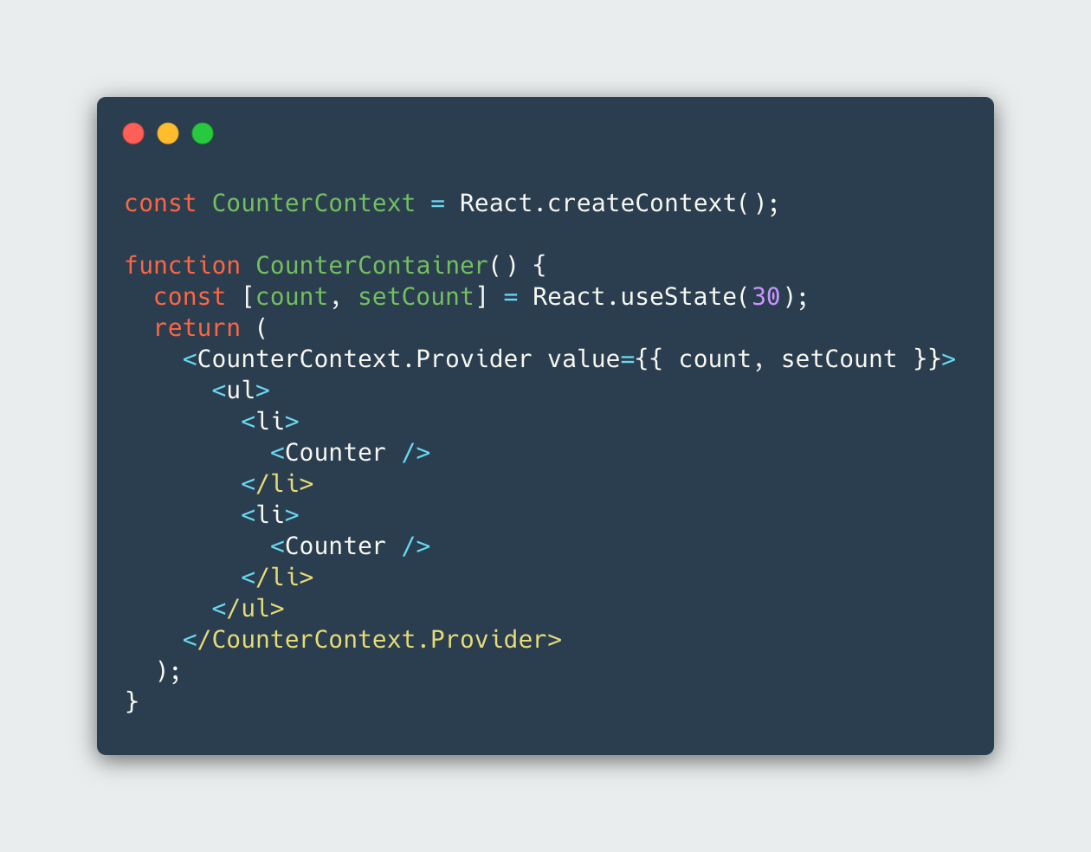
useContext
@leimonio

Slide 30
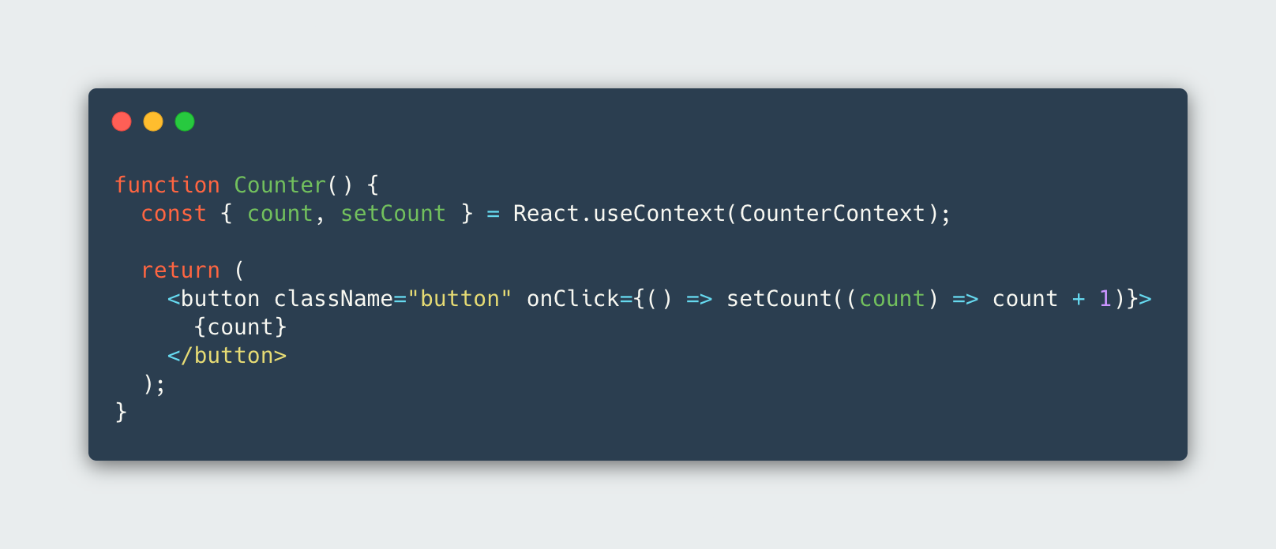
useContext
@leimonio

Slide 31
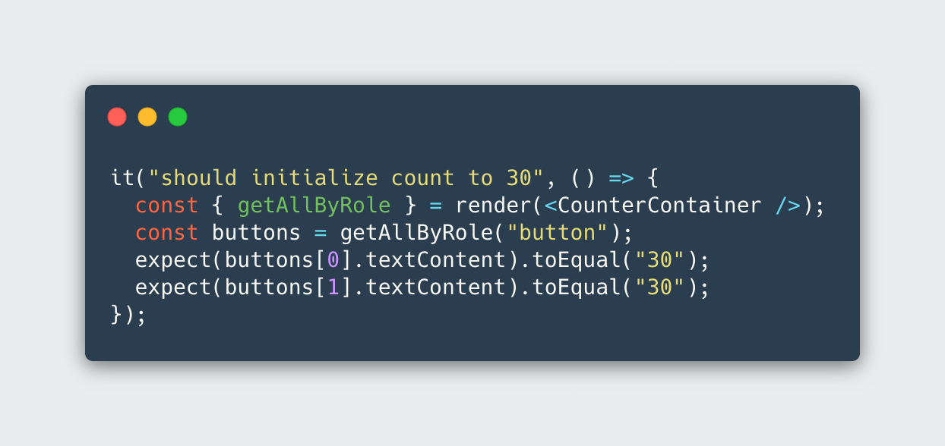
useContext
@leimonio

Slide 32
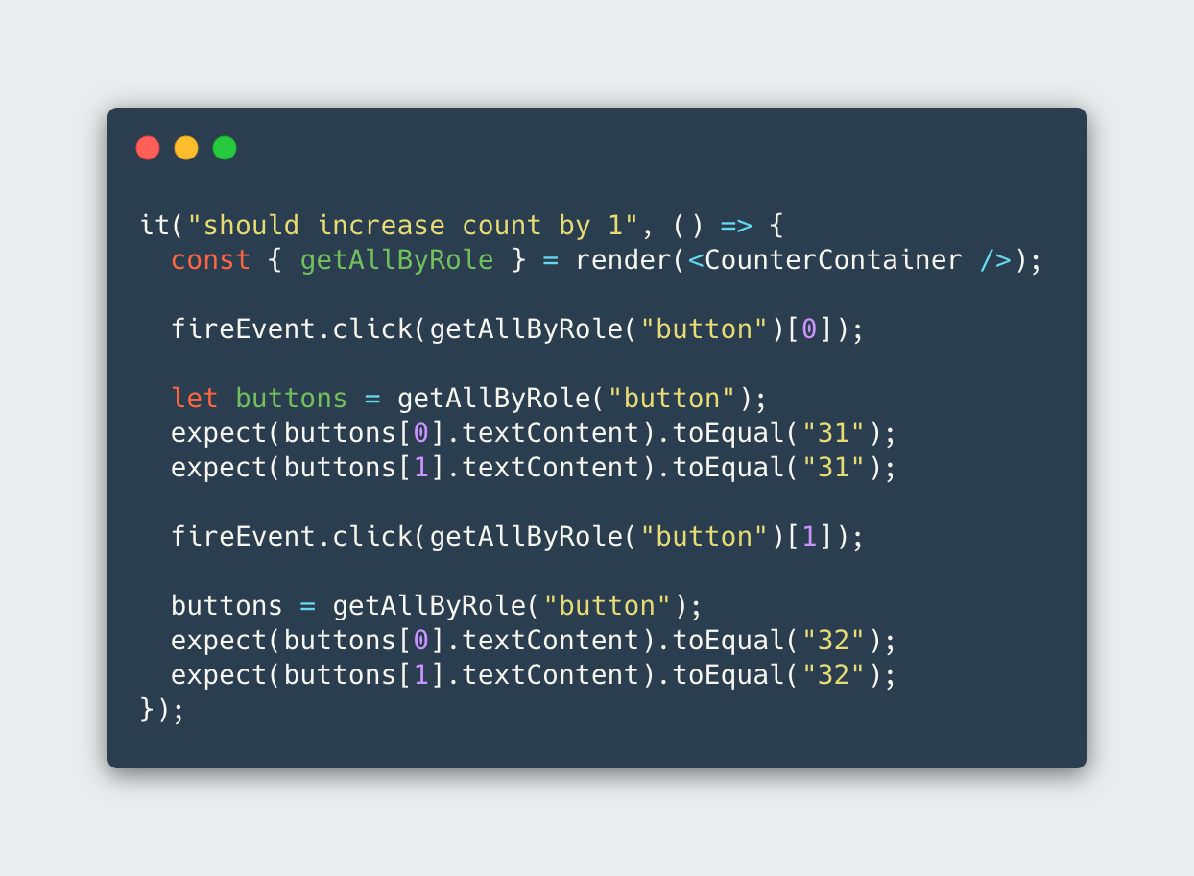
useContext
@leimonio

Slide 33
Bonus:
useContext & sideEffect
@leimonio

Slide 34
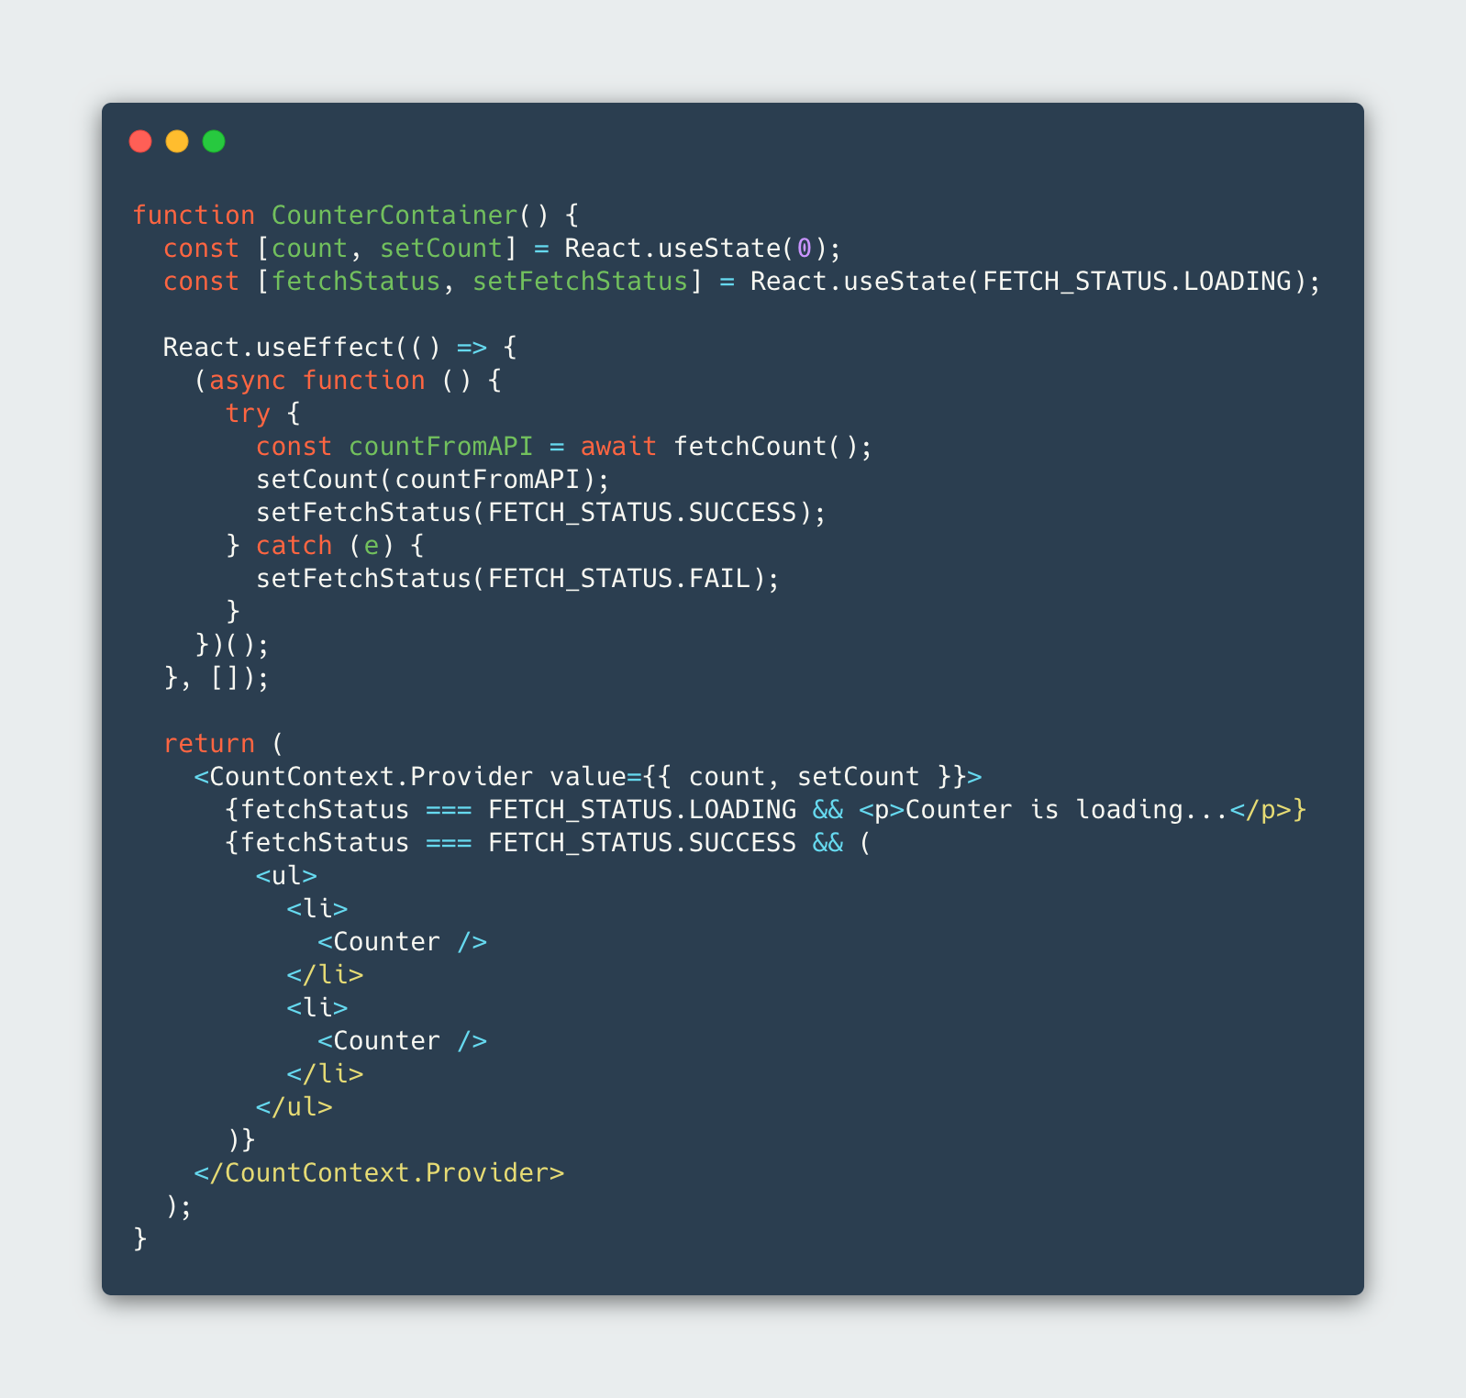
@leimonio

Slide 35
@leimonio

Slide 36
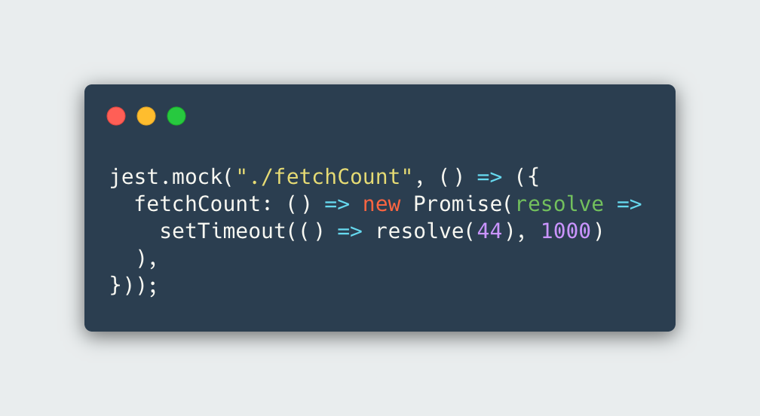
@leimonio

Slide 37
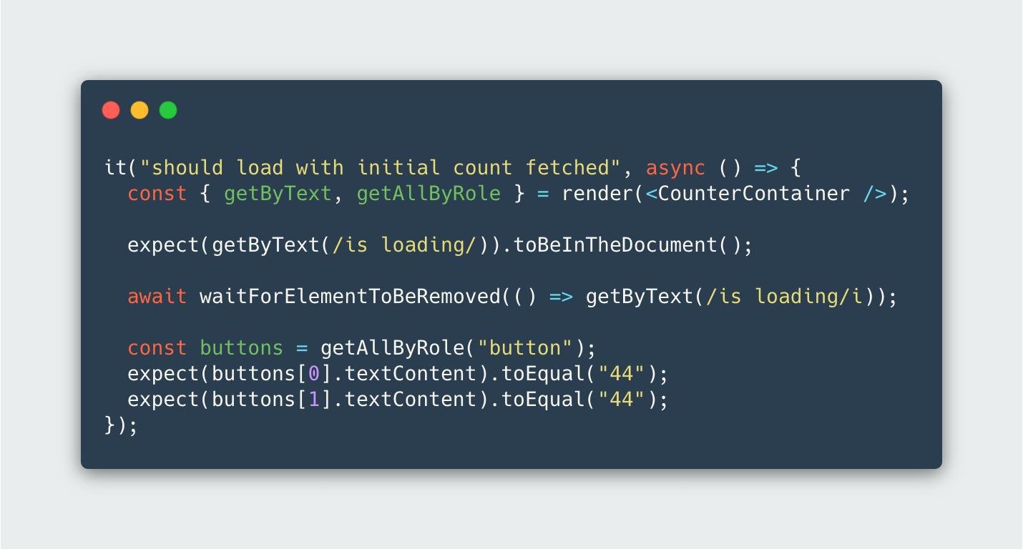
@leimonio

Slide 38
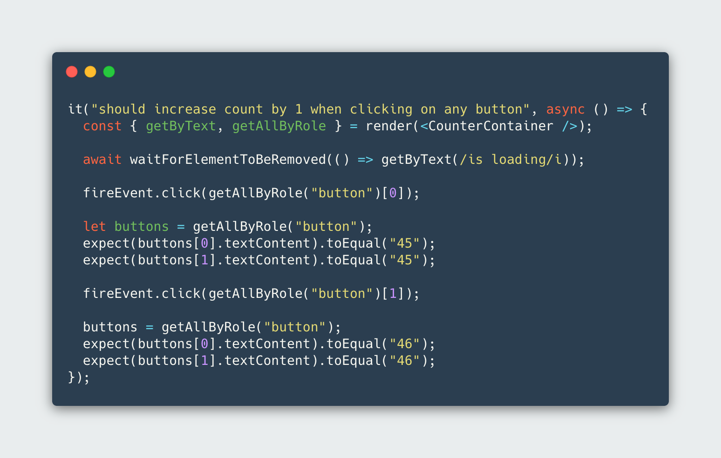
@leimonio

Slide 39

Wrap Up
Testing with Confidence
No implementation details
Result of the hooks
Effortless refactoring
https://github.com/leimonio/react-hooks-testing
@leimonio

Slide 40



Thank you!
hey@leimon.io
https://leimon.io/
https://github.com/leimonio
https://twitter.com/leimonio

